Slide 1
How did the Frontier Influence American Development

Slide 2
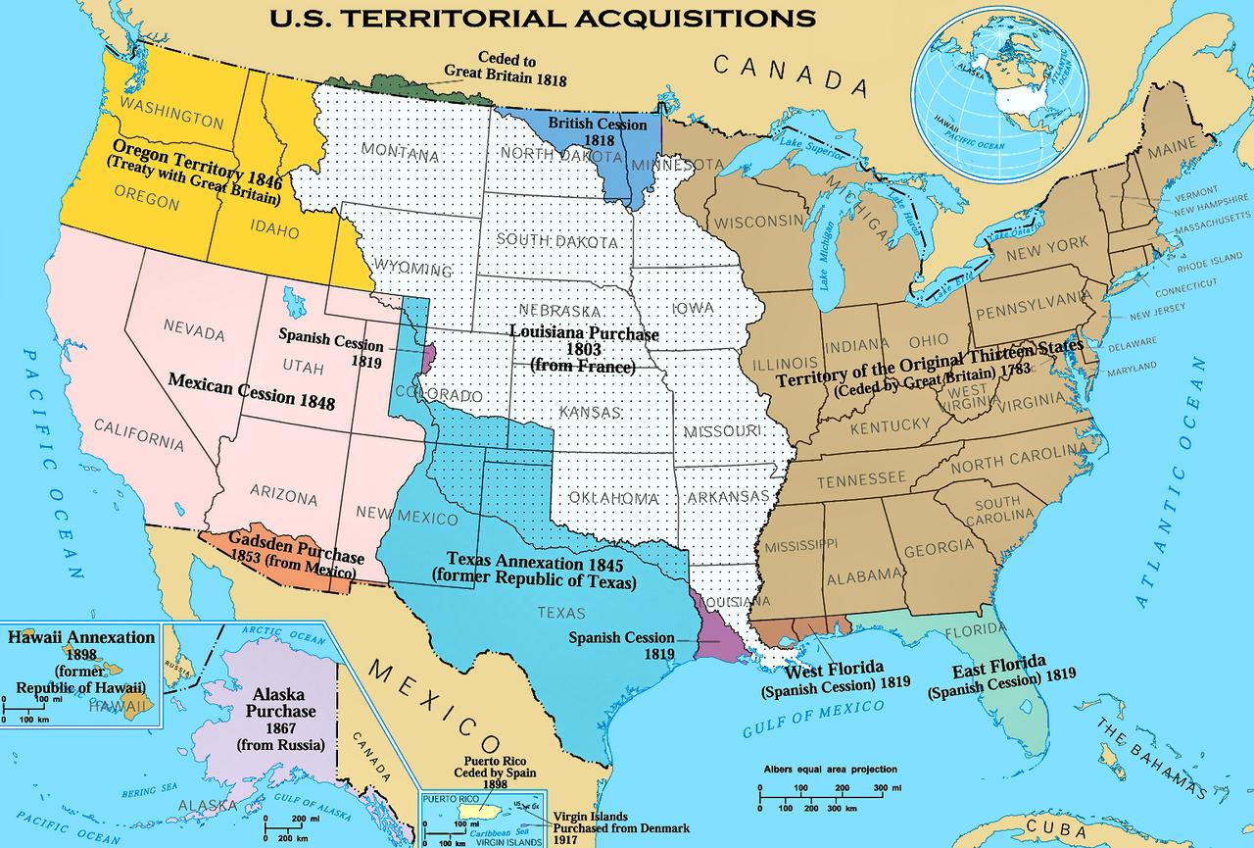
The Frontier: Definition
farthermost region of settlement;
imaginary line dividing civilization from wilderness;
*Westward expansion

Slide 3
Westward Expansion- Go West, young man!

Slide 4
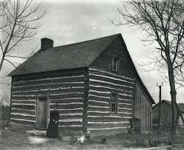
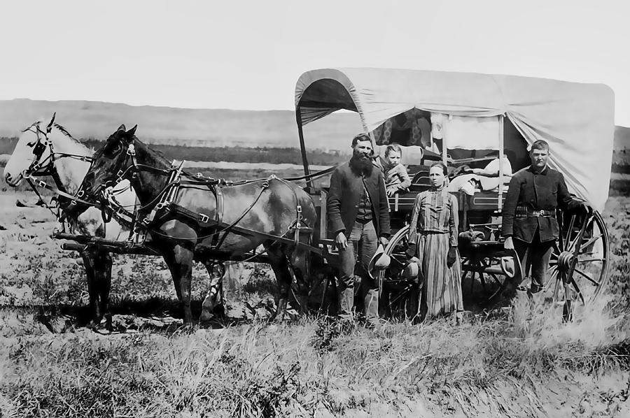
I. Westward Migration
A. Reasons:
Improvement of Economic Conditions:
land of opportunity – fertile land, fur-bearing animals, timber and precious minerals such as gold, silver, copper and iron;
2. Adventure: Native-Americans, wild animals, rugged country, unexplored regions attracted people seeking adventure and discovery;
Greater Social and Political Democracy
less rigid class distinctions

Slide 6
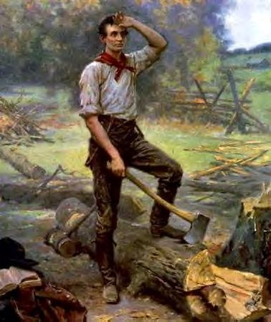
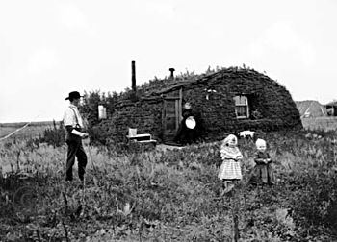
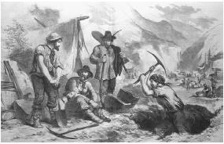
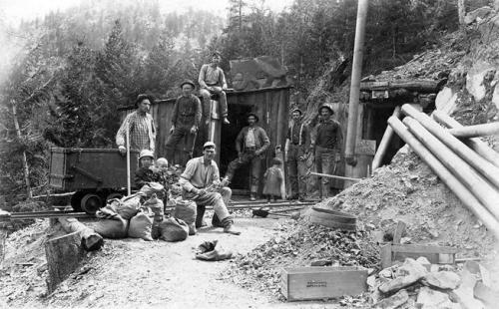
Westward Migration
B. Farmers and Miners
Farmers:
fertile lands, ads, lands, Homestead Act, troops
2. Miners:
gold rush of 1849; of 1875
By 1880s – big businesses took over the mining;

Slide 7
Expanding Across the Plains

Slide 8
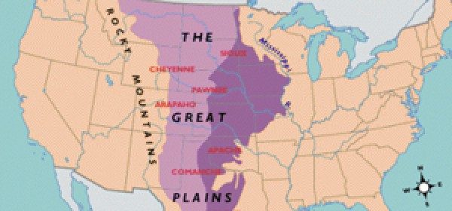
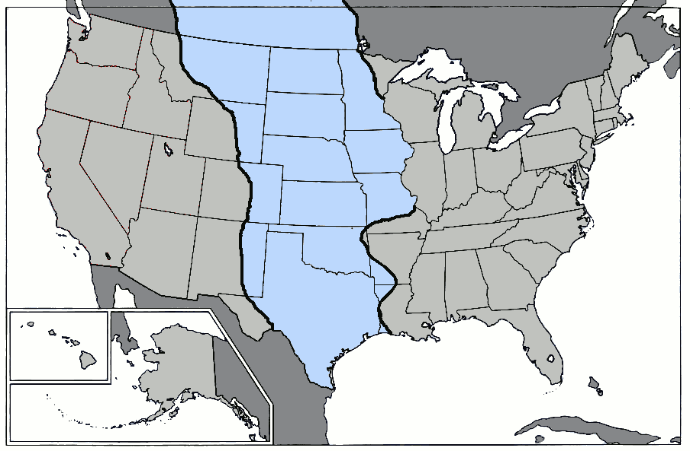
II. The Great Plains
A. Location:

Slide 10
II. The Great Plains
Railroads:
In 1869, the Union Pacific and the Central Pacific Railroad came together at Promontory Point, Utah, to complete the first transcontinental railroad.
By the 1890s, American railroad builders had completed four more transcontinental railroads.
The railroads were the fastest and most convenient means of reaching the Great Plains and the Far West.
Related Industries:

Slide 11
Transcontinental Railroads

Slide 12
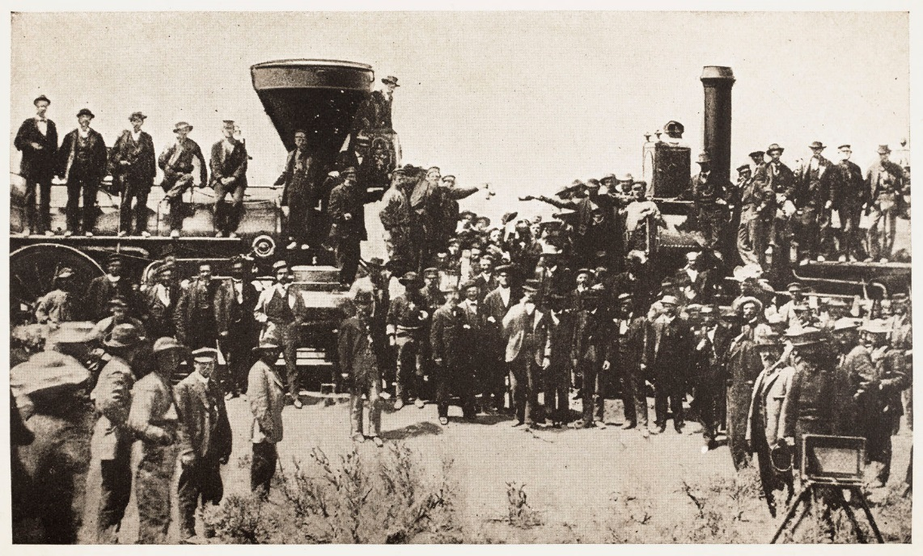
Railroads

Slide 14
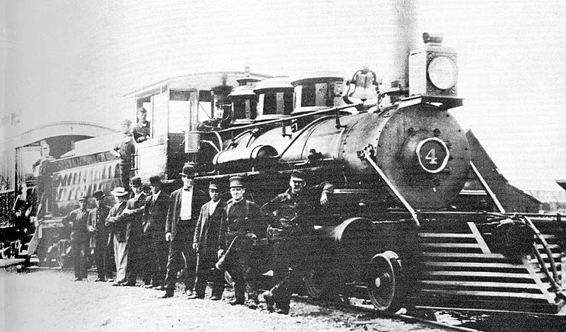
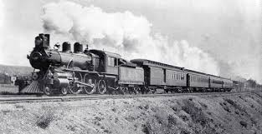
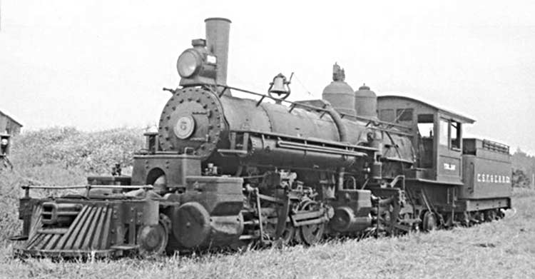
Steam Locomotives

Slide 15
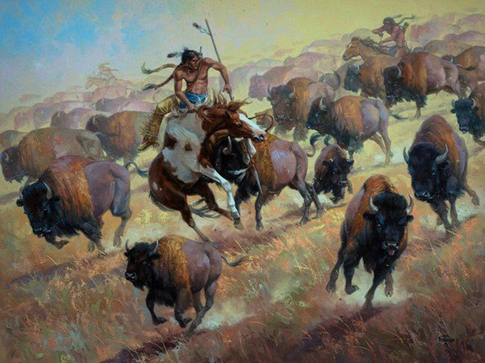
II. The Great Plains
Indian(Native-American) Problem
1. Hostility: The Plains Indians(Commanches, Cheyennes, and Sioux) were nomadic, horse-riding peoples. Used the buffalo for food, clothing and shelter. Resented the whites because:
a. settlers took Indian lands
b. hunters wantonly killed the buffalo for pelts and sport,
c. new communities upset the migratory paths of buffalo herds
d. traders and government officials cheated and robbed the Indians and broke promises.

Slide 16
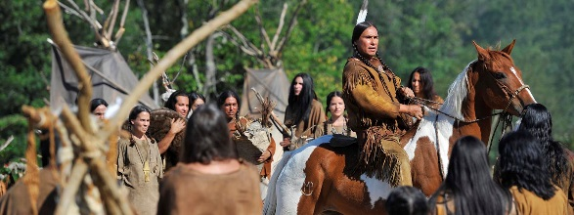
Native Americans

Slide 17
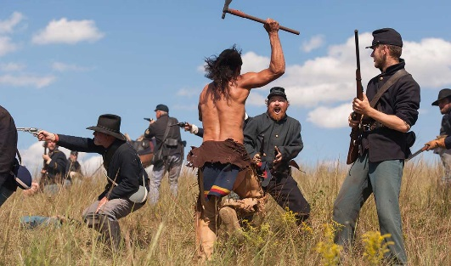
II. The Great Plains cont.
C. Native-American Problem cont:
2. Indian Wars:
For about 25 years the Plains Indians battled wagon trains, settlers, and federal troops in savage guerrilla warfare.
The Sioux, led by Sitting Bull, overwhelmed General Custer’s army at the Battle of Little Bighorn.
Despite this and smaller victories, the Indian struggle was doomed. Why?
The Indians lacked manpower, organization, equipment and – with the extermination of the buffalo – food. The last battle – the Indians call it a massacre – took place in 1890 when federal troops wiped out a Sioux band under Chief Big Foot at Wounded Knee, South Dakota.

Slide 18
II. Great Plains cont.
C. Native-American Problem cont.
3. Indian Reservations:
By the 1890s, most Indians were confined to specific, usually undesirable, lands called reservations.
No longer a free people, they received from the federal government food, clothing, and shelter and were treated as legal dependents.
Their very existence was under the control of federal Indian agents, many of whom were corrupt and unsympathetic to Indian needs.

Slide 19
Assimilation: Good or Bad?

Slide 20
How did the Indians feel?
I cried aloud, shaking my head all the while I felt the cold blade of the scissors against my neck and heard them gnaw off one of my thick braids. Then I lost my spirit.
Red Bird

Slide 21
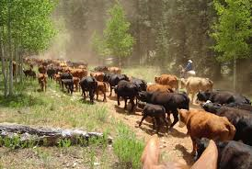
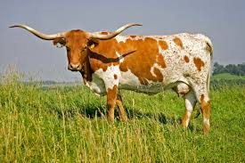
II. Great Plains cont.
D. Cattle Kingdom
The Long Drive.
Cattle worth $4 a head in Texas were worth $40 a head in Chicago. Cowboys began the long drive northward – more than a thousand miles – to deliver the cattle to the nearest railroad towns, located mostly in Kansas.
The fed the moving herds on the open range. They fought stampedes, Indians, rustlers and farmers.
There were great profits.

Slide 22
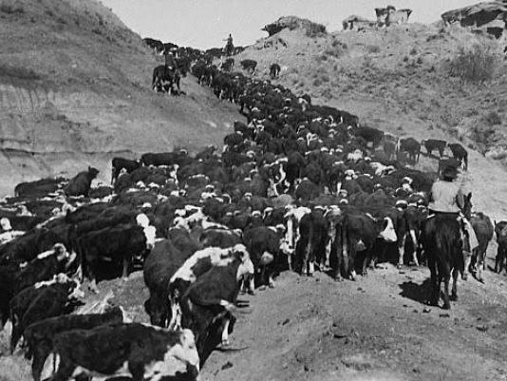
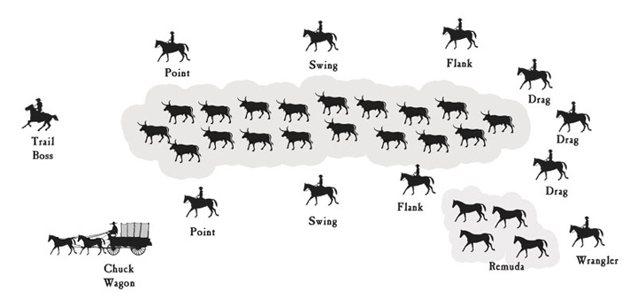
The Cattle Drive

Slide 24
The Cowboy: Freedom, Independence, Toughness

Slide 25
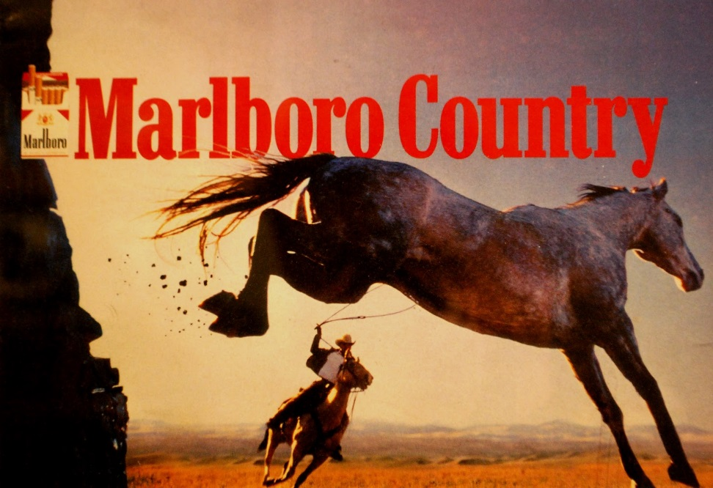
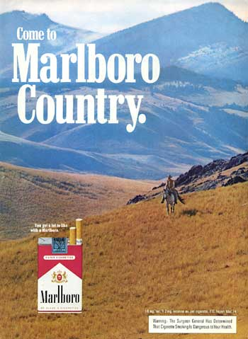
The Marlboro Man Cigarette Ads

Slide 26
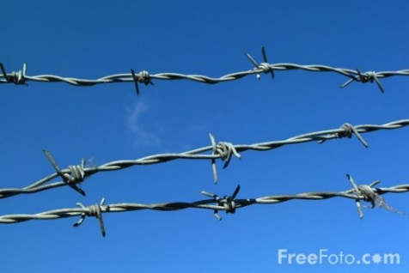
II. Great Plains cont.
D. Cattle Kingdom cont.
2. Collapse:
Greedily, ranchers overgrazed the open range; efficiency drove beef prices sharply downward.
Farmers, arriving in ever increasing numbers, fenced in parts of the open range, reducing grazing lands. This led to bitter range wars between ranchers and farmers.
From 1885-1887, natural disasters struck, incl. severe winters and dry summers destroyed entire herds.
Eventually, big-business operators took over the cattle industry: improved quality by better breeding, moved cattle to market by railroad lines.

Slide 27
II. Great Plains cont.
E. The Farmer on the Great Plains
Why settle on the Plains?
1. fertile Soil;
2. With railroads, good transportation; machinery from east ad farm products to east;
3. Homestead Act(1862) free 160 acre farm to any settler who could cultivate it for 5 years (less than 1/5 secured free homesteads.
Most settlers forced to buy the more desirable lands that were granted to the railroads or to the states or that were acquired by land speculators.

Slide 28
Technology on the Plains
introduction of barbed wire;
Pumped up water form far below the surface by using pumps and small, metal windmills;
Dry farming techniques – plowing deep for subsurface moisture and pulverizing the soil to slow down evaporation.
New, hardier strains of winter wheat; drought resistant strains of wheat and corn;
More machinery: grain drills, reapers, harvesters, threshers

Slide 29
Violence in the West: The Wild West
early settlements and new towns; no or limited law enforcement; distances too vast; reliance on vigilante justice
settlers, miners and ranchers have guns;
hunting,
self-defense,
Indians
range wars between cattle ranchers and farmers;
American characteristic: need not back down from a threat;

