Slide 1
The Byzantine Empire

Slide 2
Basic Features of Byzantine Civilization
Roman Imperial in its form of government;
Orthodox Christian in religion
Greek in its culture and language

Slide 3
From Eastern Roman to Byzantine Empire
Constantinople – imperial capital; center of a world empire; a Christian city under the protection of God;

Slide 4
B. Justinian (527-565)
Reconquers the Western Territories
Determined to re-establish Roman rule in the west; attempted to reconquer; regains parts of North Africa, southern Italy; and parts of Spain;
Criticized for overextending resources and draining revenue;
Devastating plague in 542;
Re-conquest of the west does not last;

Slide 5
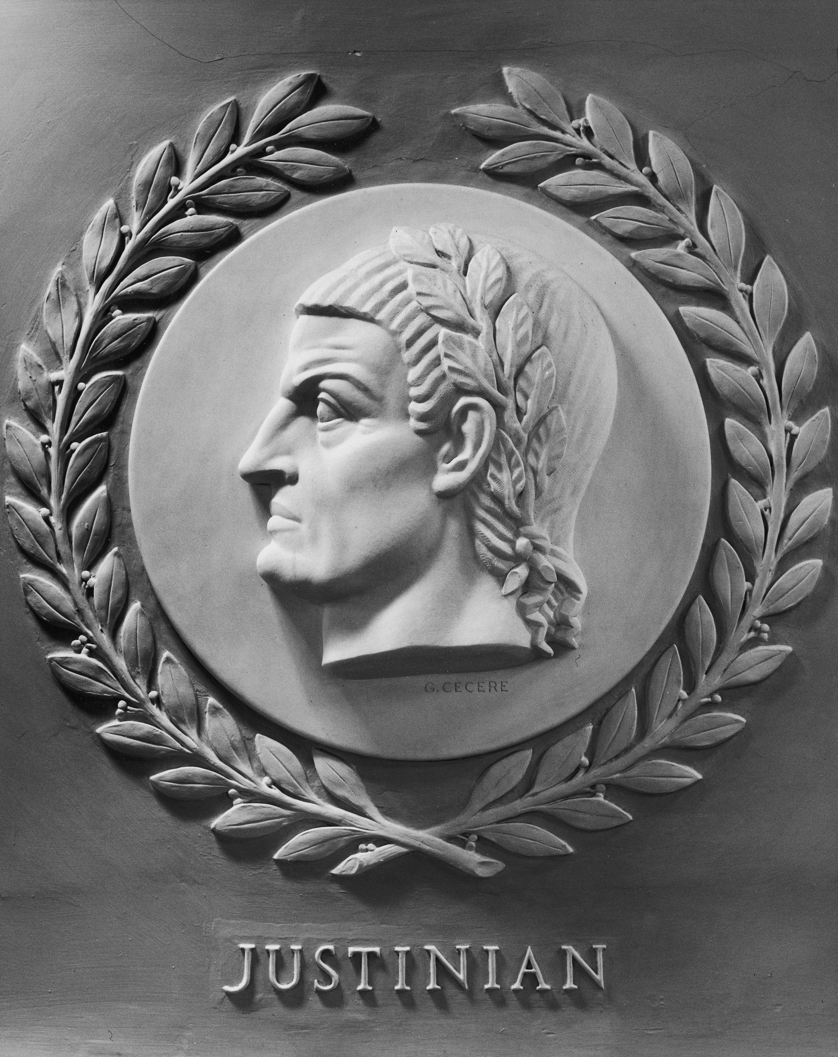
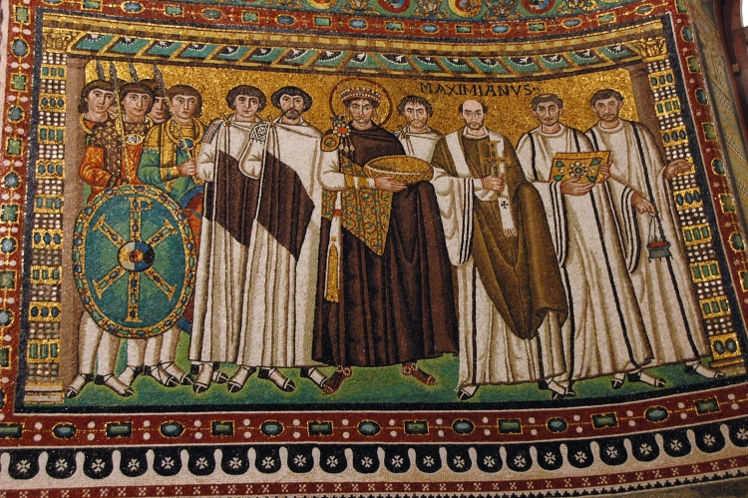
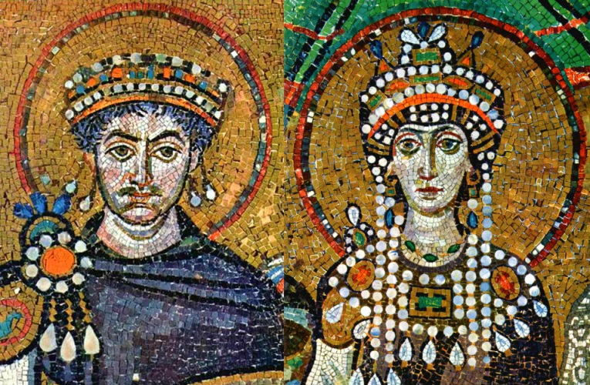
Justinian

Slide 6
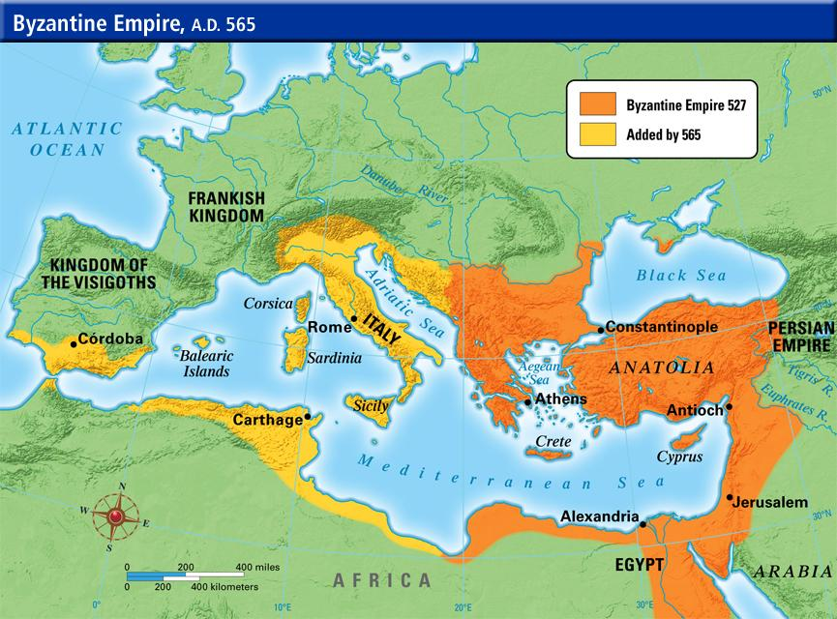
Byzantine Empire Under Justinian

Slide 7
Justinian’s Code
Codification of Roman Law(Justinian’s Code)
Justinian’s most lasting contribution;
Roman law after centuries was a mass of laws passed by the Senate and assemblies, legal commentaries of jurists, decisions of praetors, edicts of emperors, …
Justinian was well trained in Imperial government and Roman law – desired to codify and simplify the mas of legal materials;
The basis of imperial law in the Empire until its end; written in Latin; basis of the legal system of all of continental Europe;

Slide 8
Justinian’s Code
A systematic compilation of imperial edicts – Corpus Iuris Civilis( Body of Civil Law)
Digest – compendium of writings of Roman jurists;
Institutes – summary of the principles of Roman Law; served as textbook;
Novels – most important new edicts issued during Justinian’s reign;

Slide 9
Justinian’s Building Program
A series of riots had destroyed much of Constantinople;
Justinian rebuilt much of the city giving it the appearance it would maintain for almost 900 years;
Enormous defensive wall to protect the capital on the land side;
Immense palace complex;
Huge arena known as the Hippodrome;
Hundreds of churches
Roads, bridges, walls public baths, law courts, colossal underground reservoirs for city’s water supply, hospitals, , schools, monasteries
Greatest achievement was Hagia Sophia - the magnificent Church of the Holy Wisdom

Slide 10
Church of the Holy Wisdom
Enormous dome which seemed to be floating in space; “as though suspended from heaven by a golden chain;”
42 windows around the base of the dome, which allowed an incredible play of light within the cathedral;

Slide 11
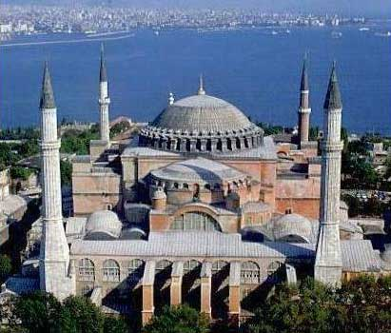
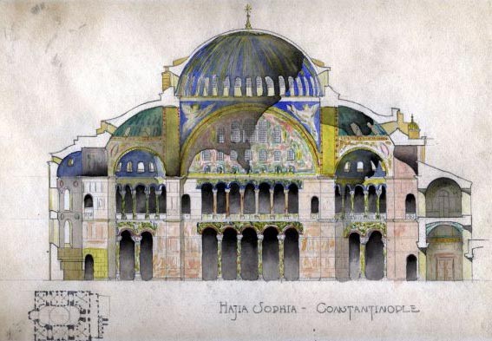
Hagia Sophia

Slide 12
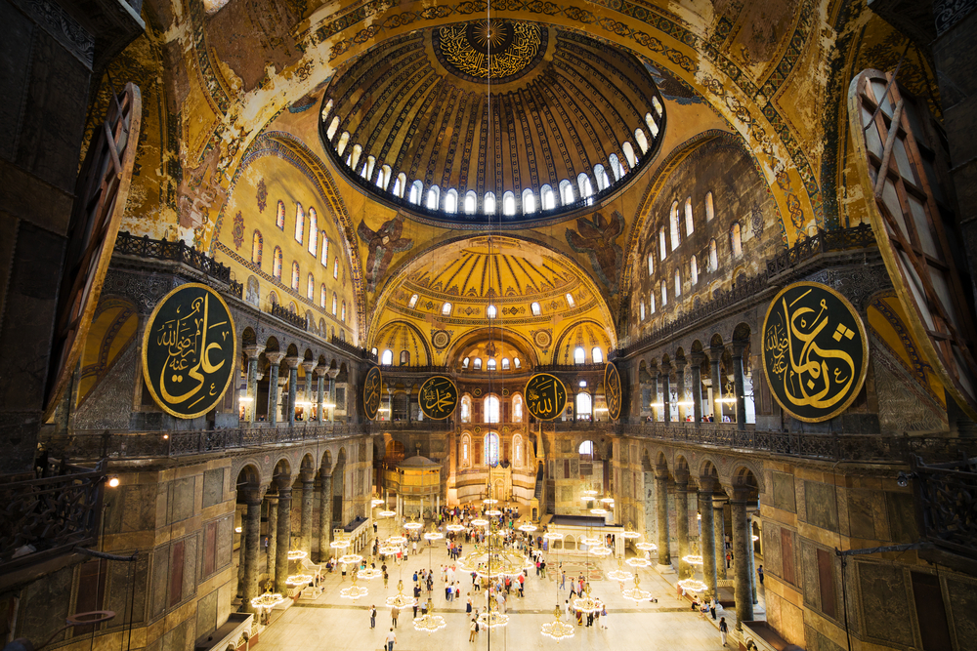
Hagia Sophia

Slide 13
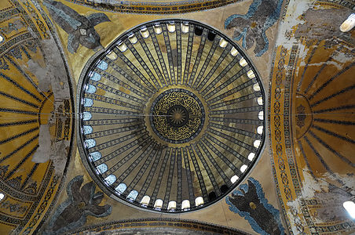
Hagia Sophia

Slide 14
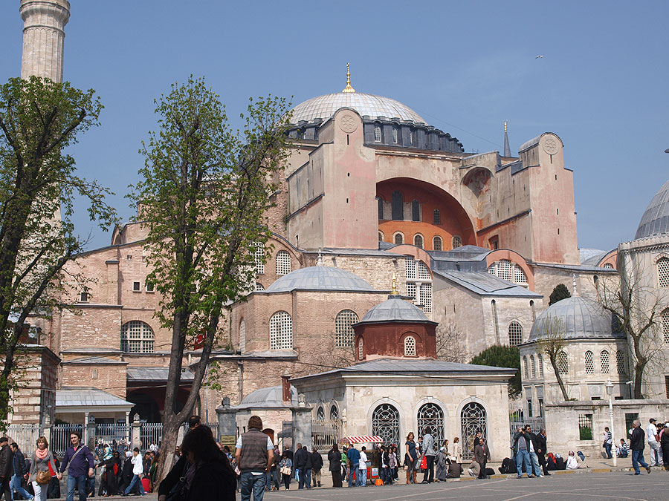
Hagia Sophia

Slide 15
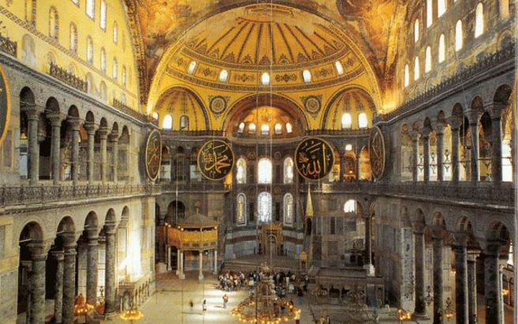
Hagia Sophia

Slide 16
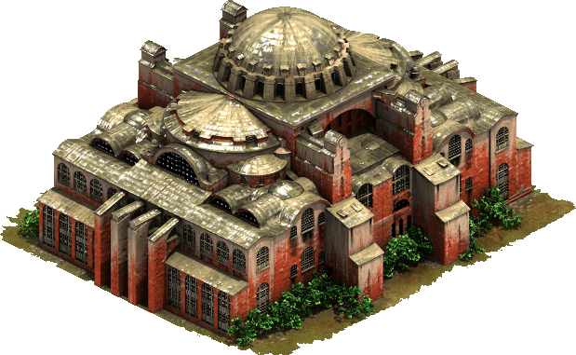
Hagia Sophia

Slide 17
The Hippodrome
Huge amphitheater constructed of brick covered by marble;
Held 60,000 spectators
Early Byzantine empire still gladiator fights;
Main events were chariot races; 24 in one day; Constantinopolitans were passionate fans;

Slide 18
Hippodrome in Constantinople

Slide 19
Problems
After Justinian died,
Distant territory to protect;
Drained treasury;
Smaller population after devastating plague;
Renewed threats to frontiers;

Slide 20
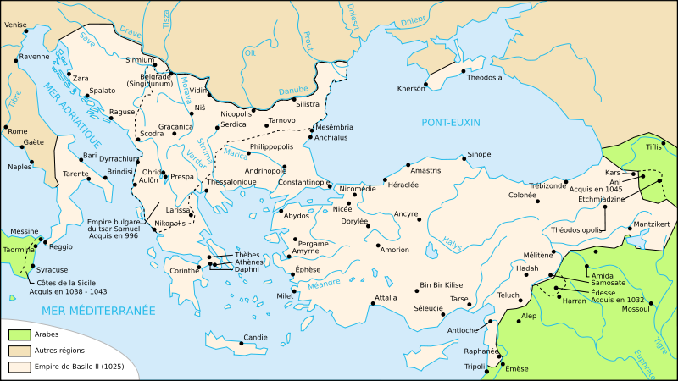

Slide 21
Threats:
Persistent attacks from Persians in east and Slavs in the North a threat;
Empire combines civil governor and military commander roles in different territories; increased militarization of the empire;
Rise of Islam: the most serious challenge;
The Byzantines successfully defend against Islamic attacks for centuries; the Islamic frontier in southern Asia Minor;
Long-standing tradition of military strategy and tactics; also Greek Fire( petroleum-based compound containing quicklime and sulfur) – equivalent of modern flamethrowers – fired from tubes on ships against enemy ships;

Slide 22
Byzantine Empire Diminishes in Size
Under persistent attacks over centuries, Byzantines reduced to an eastern Mediterranean state;

Slide 23
Iconoclasm
Internal struggle over the appropriateness of sacred images depicting Jesus and the saints;
Forbidden in Judaism and Islam;
Orthodox Church affirms Jesus can be depicted because of the fundamental truth of Christianity, the Incarnation – God became man, took on a human body;

Slide 24
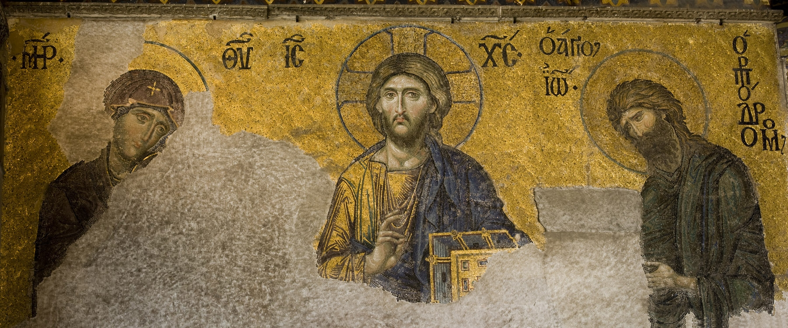
Sacred Images

Slide 25
Emperor
Portrayed as chosen by God;
Crowned in elaborate sacred ceremonies;
Subjects expected to prostate themselves in his presence;
Sophisticated and elaborate court rituals;
Power was absolute
Ruling class – civil servants and high churchmen; well educated; this strong bureaucracy was a basic feature of the Empire;

Slide 26
Permanent War Economy
State regulation of economic affairs; the survival of the Empire depended on careful maintenance of economic resources and the maintenance of the army;
Encouraged agricultural production, regulate guilds, industries, manufacturing and commerce(trade);
Government monopolies on grain and silk;
Armies well trained and equipped with the latest weapons;
Preference for diplomacy over rather than fighting;
Masters of diplomacy – complex and crafty in negotiations – the word byzantine in English denotes crafty, sneaky, complicated, intricate;

Slide 27
Intellectual Life
Greatly influenced by the traditions of classical Greece and Rome;
Scholars preserved the works of the ancient Greeks;
Imitated classical models;
Large body of literature
Historical works
Religious works – theological treatises, lives of saints, beautiful sacred hymns and poetry;
Books on military tactics;
Photius the Great – the most learned man of the Middle Ages

Slide 28
The Importance of Trade
Constantinople the largest city in Europe in the Middle Ages;
until the 12th century, Europe’s greatest commercial center;
located at center of trade between east and west; the basis for the city’s fabulous prosperity;
Highly desired in Europe: silk, spices, jewelry, ivory; wheat and furs from Russia;
Byzantine imperial monopoly on silk production; (silkworms smuggled from China);
Important: upper classes not discouraged from making money through trade and manufacturing;

