Slide 1
Vocal music course offerings 2021-2022 School year

Slide 2
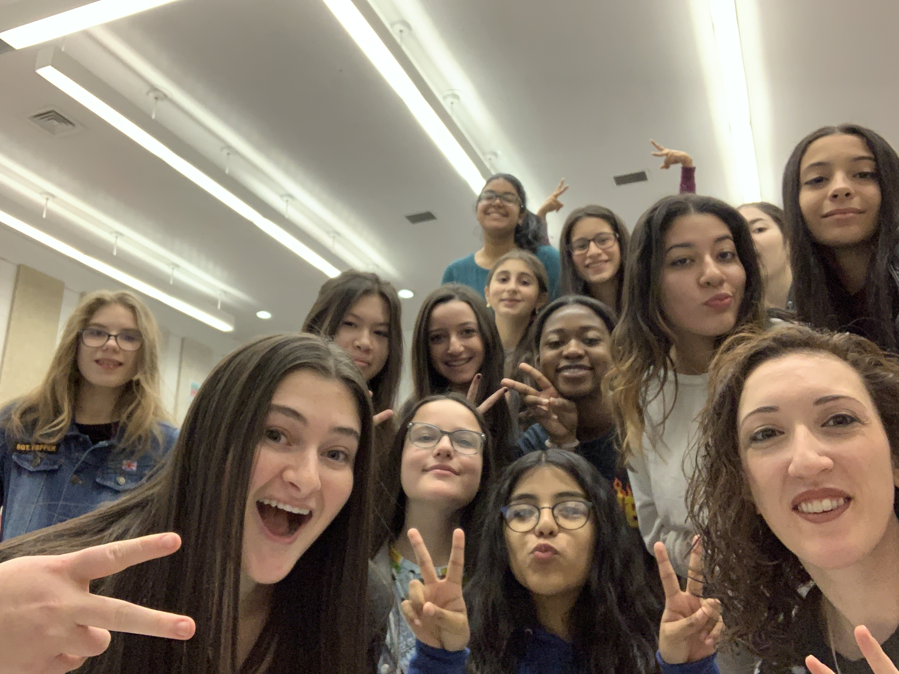
Treble chorus
Meets every day for an entire year
A chance to relax, sing, and be among friends
A class to feel good about singing no matter what your ability level is

Slide 3
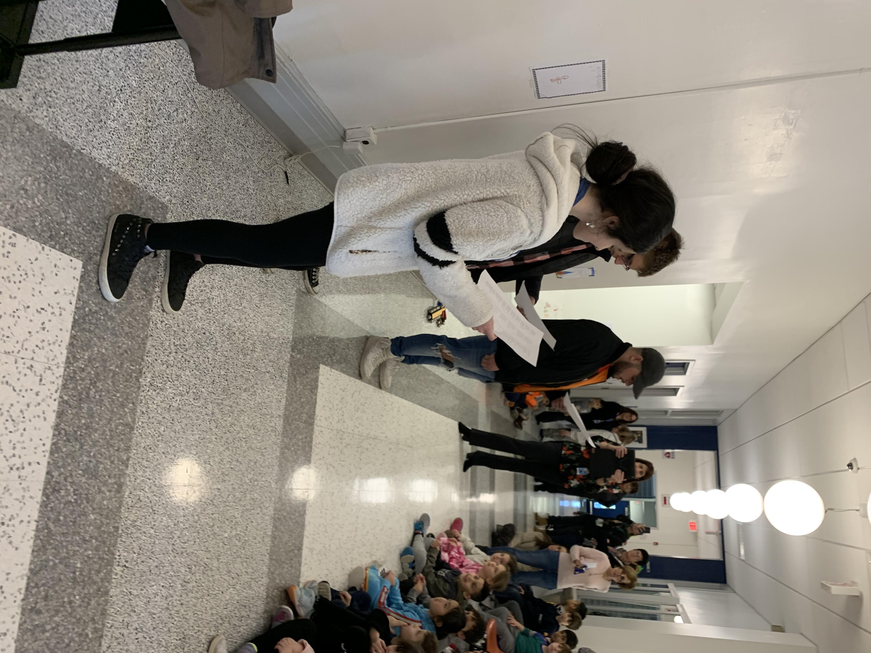
MIXED chorus
Meets every Tuesday, 10th period (2:45-4:00) for an entire year
A chance to sing popular songs, songs from Broadway, and learn harmonization skills
A class for anyone to come sing!
No audition

Slide 4
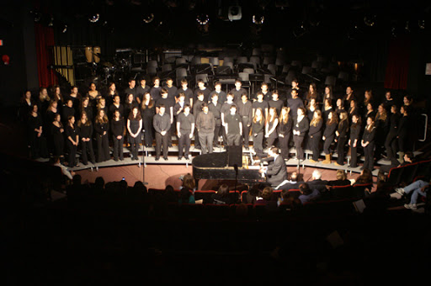
CHAMBEr chorus
Meets every Friday, 10th period (2:45-4:00) for an entire year
Has the option to receive COLLEGE CREDIT from LIU
An auditioned group
This is an smaller, select group of singers

Slide 5
THEATER course offerings 2021-2022 School year

Slide 6
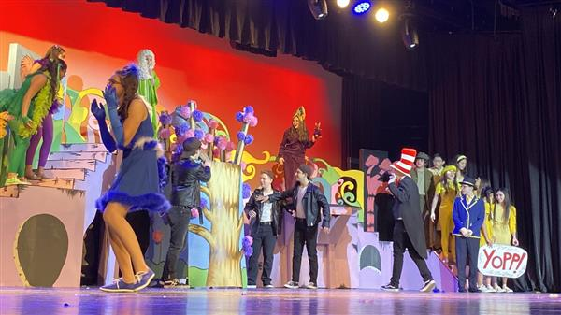
MUSICAL THEATER
Meets every day for 1 semester
A chance to perform a small-scale musical production
A class for those who love to sing, act, and perform
An opportunity to learn audition and performance skills

Slide 7
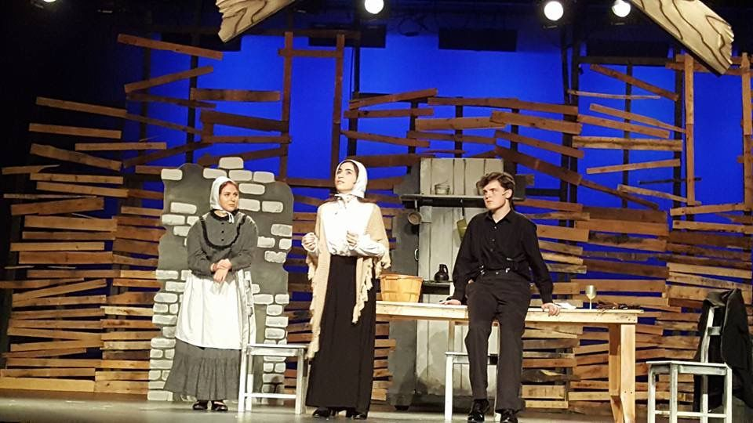
THEATER CLASS
Meets every day for 1 semester
A chance to perform a small-scale musical production
A class for those who love to sing, act, and perform
An opportunity to learn audition and performance skills

Slide 8
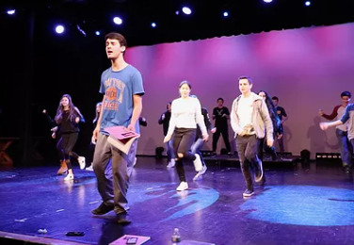
College theater
Meets every day for an entire year
Has the option to receive COLLEGE CREDIT from LIU
For those who meet pre-requisites or teacher recommendation
Class goes further into acting technique while acquiring skills to pursue a career and/or life long interest in the arts

